Slide 1
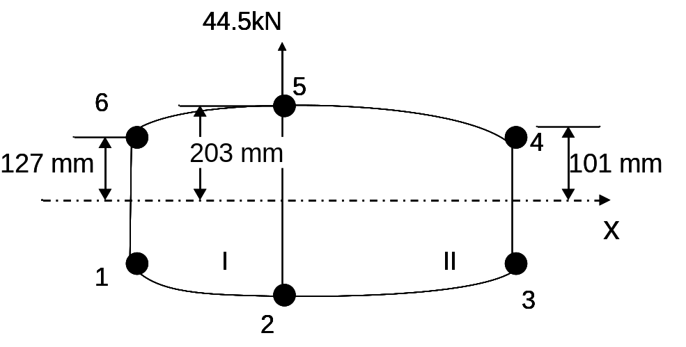
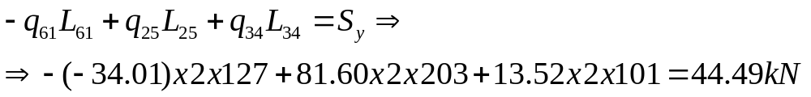
Example: Determine shear flows for a two-cell beam
q_{b65}=q_{b12}=q_{b45}=q_{b23}=0
q_{b61}=-34.01 N/mm
q_{b25}=81.60 N/mm
q_{b34}=13.52 N/mm
check so far: if the shear flows are correct, vertical equilibrium should be maintained, i.e.,
?
now close the cuts, apply a constant shear flow in each cell, and use the equations for the rate of twist and moment equivalence

Slide 2
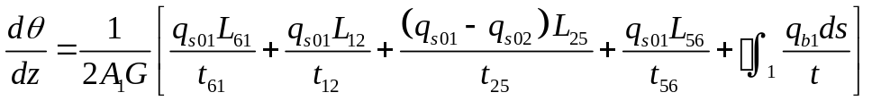
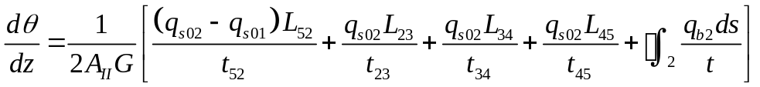
Example: Determine shear flows for a two-cell beam
the rate of twist equation, (9.3):
q_{s01}
q_{s02}
(9.3)
applied to each of the two cells, gives:
(9.3a)
these two can be eval- uated because the shear flows q_{b} corres- ponding to the cut cells have already been determined
(9.3b)

Slide 3
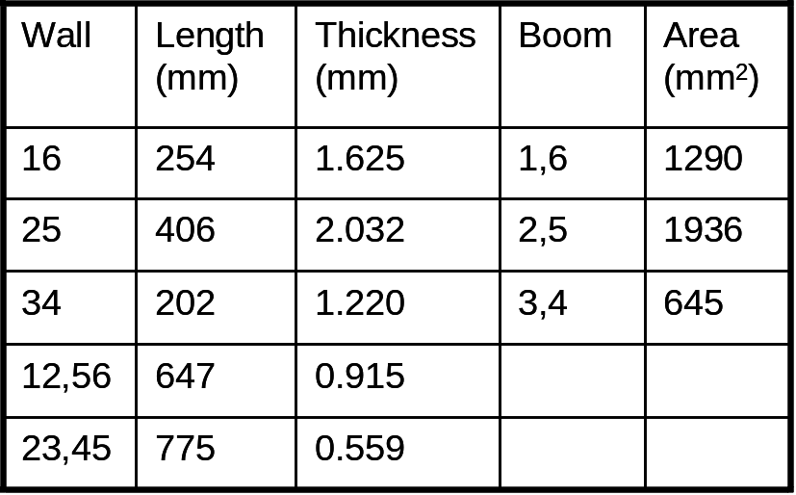
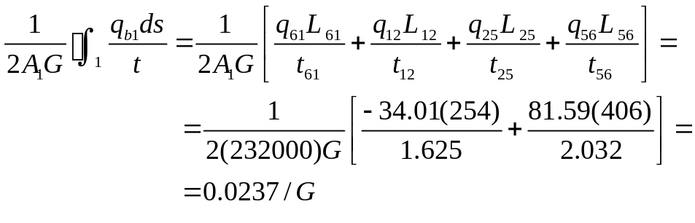
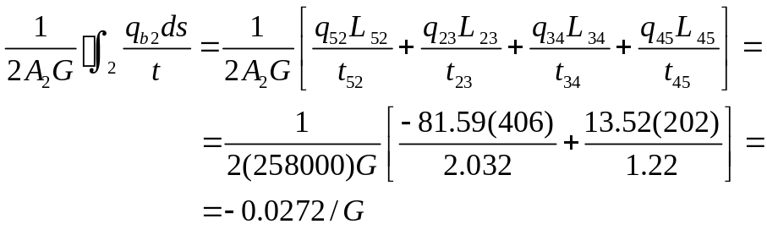
Example: Determine shear flows for a two-cell beam
A_{I}=232000mm²
A_{II}=258000mm²

Slide 4
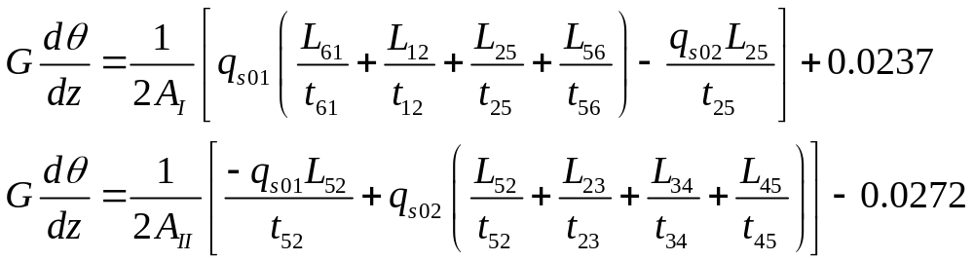
Example: Determine shear flows for a two-cell beam
A_{I}=232000mm²
A_{II}=258000mm²
(9.3a)
(9.3b)
substitute the result for the line integrals in (9.3a) and (9.3b)

Slide 5
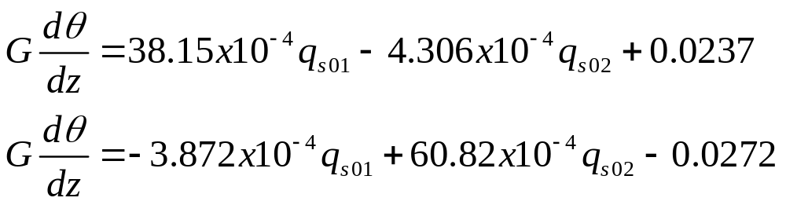
Example: Determine shear flows for a two-cell beam
A_{I}=232000mm²
A_{II}=258000mm²
substituting:
(9.3c)
(9.3d)

Slide 6
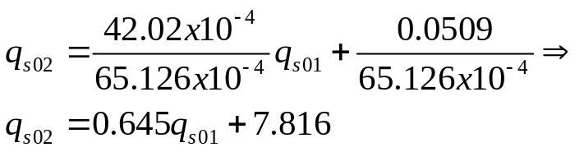
Example: Determine shear flows for a two-cell beam
A_{I}=232000mm²
A_{II}=258000mm²
(9.3c)
(9.3d)
eliminating Gdθ/dz from (9.3c) and (9.3d):
or
(10.1)

Slide 7
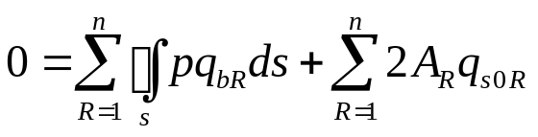
Example: Determine shear flows for a two-cell beam
A_{I}=232000mm²
A_{II}=258000mm²
the remaining equation is obtained from moment equivalence, eq. (9.5)
(9.5)
we’ll take moments about the mid-point of web 52 (so that S_{y} does not cause a moment and the left hand side of (9.5) is zero); to do that we need two moment arms

Slide 8
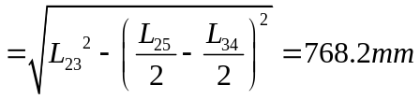
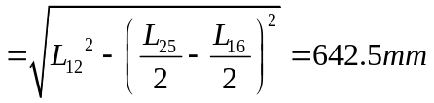
Example: Determine shear flows for a two-cell beam
A_{I}=232000mm²
A_{II}=258000mm²
note that, for simplicity in the calculations, the curved lines 12, 56, etc are assumed straight here
(9.5)
substitute now in eq (9.5):
or
(10.2)

Slide 9


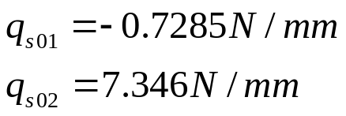
Example: Determine shear flows for a two-cell beam
(10.1)
(10.2)
equations (10.1) and (10.2) form a system of two equations in the two unknowns q_{s01} and q_{s02}; the solution is:
combining these with the open-section shear flows we found earlier, we obtain the complete solution
q_{b65}=q_{b12}=q_{b45}=q_{b23}=0
q_{b61}=-34.01N/mm
q_{b25}=81.59N/mm
q_{b34}=13.52N/mm

Slide 10
Example: Determine shear flows for a two-cell beam
44.5kN
0.7
7.35
5
(all shear flows are in N/mm)
6
73.5
4
34.7
20.9
I
II
why is this correct?
see lecture 9! (and next page)
1
3
0.7
2
7.35
note that the final set of shear flows should also reproduce the applied loads
vertical equilibrium:
5
horizontal equilibrium is satisfied by inspection

Slide 11
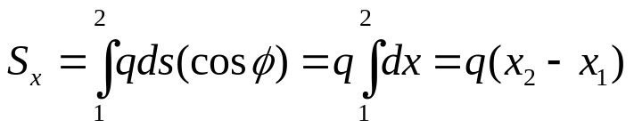
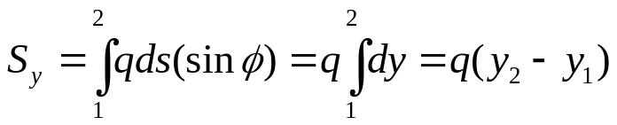
Booms under shear loads – open sections –some useful conclusions
s
x
(x₁,y₁)
q₁₂ = const = q
ds
q₁₂
horiz force component=qds(cosφ)
vert force component=qds(sinφ)
dy
dx=ds(cosφ)
dy=ds(sinφ)
y
dx
φ
(x₂,y₂)
if we assume an idealized structure, calculation of the total force in any direction is very simple
total force in x direction is
total force in any direction between two points equals the shear flow times the distance between the points parallel to that direction
total force in y direction is

Slide 12
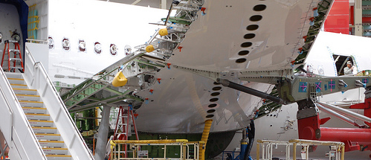
Cut-outs are inevitable
cut-outs
access panels, inspection panels
accommodation for other parts (e.g. engine nacelles, etc)

Slide 13
Cutouts: Repeating or periodic cutouts (“fuselage” windows)
Megson 22.4, 23.8
q_{av}
window cutout
q₂
q₃
q₂
q₃
q₂
q_{av}
d₁
(dotted lines denote stiffeners or booms)
q₁
q₁
d_{w}
q₂
q₃
q₂
q₃
q₂
d₁
ℓ_{w}
ℓ₁
ℓ_{w}
ℓ₁
ℓ_{w}
a known shear flow q_{av} is applied away from the window cutouts; it is required to find the shear flows in the panels near the cutouts
ℓ
Note that the pattern repeats both longitudinally and circumferentially
(that’s how it is done in Megson)

Slide 14
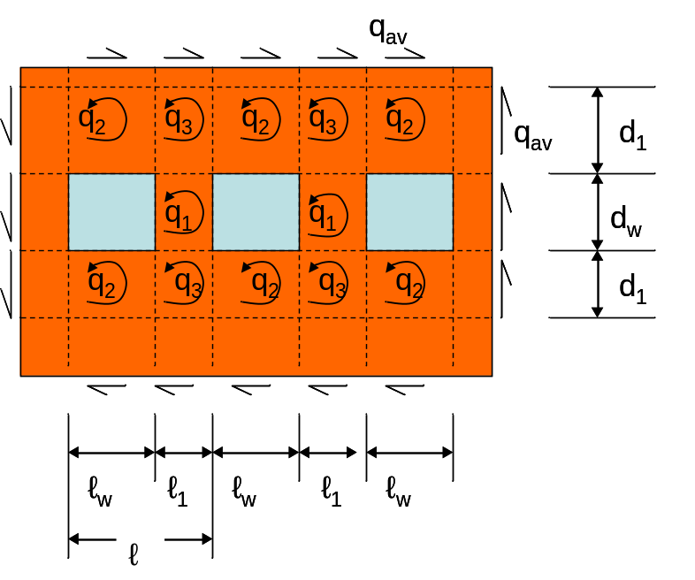
Cutouts: Repeating or periodic cutouts (“fuselage” windows)
because of symmetry and periodicity, there are three unknown shear flows: q₁, q₂, and q₃
it is important to select the “repeating unit” which will be placed in force equilibrium
the conditions are (a) that it repeats and (b) that the shear flow q_{av} along its top and bottom edge equals the shear flow q_{av} along its left and right edge
Horizontally, the structure repeats every ℓ_{w}+ ℓ₁. This means that the vertical dimension h of the repeating unit should be such that moment equilibrium is satisfied

Slide 15
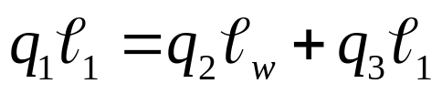
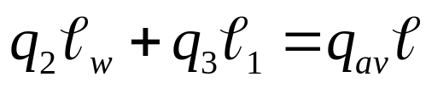
Cutouts: Repeating or periodic cutouts (“fuselage” windows)
consider horizontal equilibrium along a line going through the window cutouts:
(10.3)
consider also horiz. equilibrium along a line above (or below) the windows
(10.4)

Slide 16
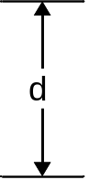

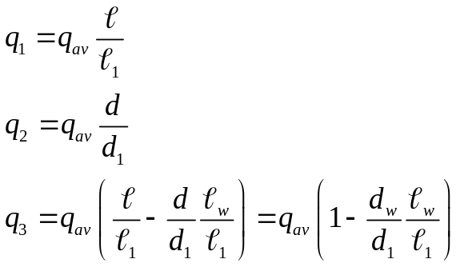
Cutouts: Repeating or periodic cutouts (“fuselage” windows)
(10.3)
(10.4)
consider vertical equilibrium along a line going through the window cutouts and extending only along the height of the repeating unit:
(10.5)
eqs (10.3), (10.4), and (10.5) form a system of three eqs in the three unknowns q₁, q₂, q₃; the solution is:
(10.6)
(10.7)
(10.8)

Slide 17
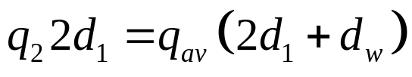
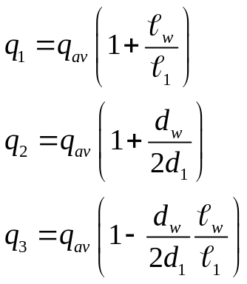
Cutouts: Repeating or periodic cutouts (“fuselage” windows)
if the cutouts repeat only longi-tudinally and not circumferentially (which is more realistic), then the vertical equilibrium equation (10.5) is modified to:
(10.5a)
the other two equations, (10.3) and (10.4) do not change; the solution now becomes:
(10.6a)
Note that q₁ is the same as before, q₂ is now smaller but q₃ is now bigger than before!
(10.7a)
(10.8a)

Slide 18
Cutouts: non-periodic
q_{av}
q_{av}
if we have a single isolated cutout in the middle of a skin, the previous solution is not valid
to solve for this case, we assume that there is no cutout originally and all shear flows are equal to q_{av}; we then add a –q_{av} shear flow in the panel corresponding to the cutout and solve for the new shear flows using equilibrium
this case is dealt in detail in the application session

Slide 19
Cutouts in wings and differential bending
wingbox cross-section
without cutout, resists torsion by twisting
with cutout, how does it resist torsion?

Slide 20
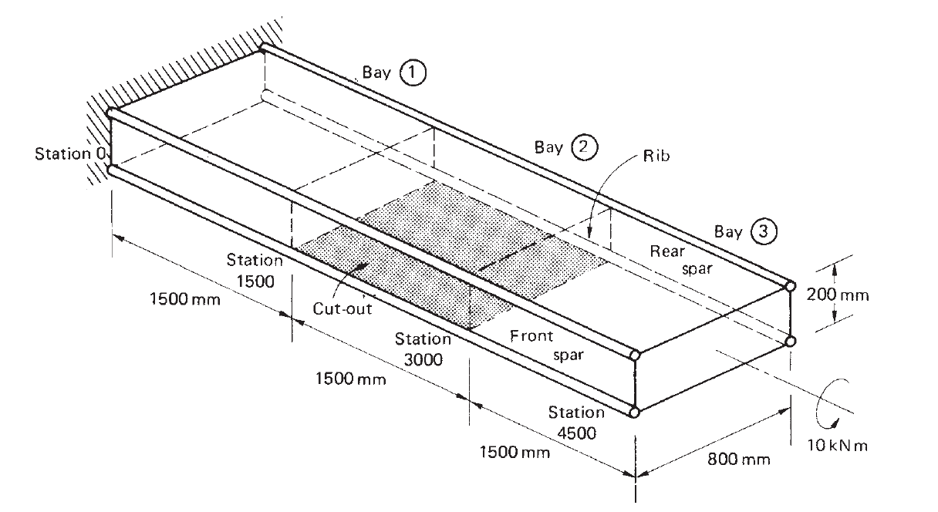
Wingbox under torque load
Rib
wingbox clamped at the root
Applied torque
calculate just about everything worth calculating

Slide 21
Wingbox under torque load
calculate:
  shear flows in skin panels and spar webs
  axial loads in corner flanges
  loads in ribs on either side of the cut-out
corner flanges
important assumption: skin carries only shear, flanges carry axial loads

Slide 22
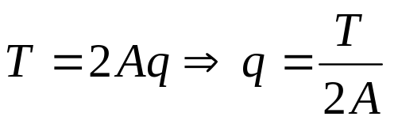
Shear flow calculations
if there were no cut-out, the shear flow in the skins would be constant and given by the torque-shear flow equation for closed beam sections:
where A is the area enclosed by the beam mid-line and T is the applied torque, with
A = 200 x 800 =160000 mm²
T = 10000Nm = 10⁷ Nmm
leading to q = 31.25 N/mm
self-equilibrating
there would be no axial load in the corner flanges (except maybe at the root) because all the torque is taken by the skin panels and the structure is balanced

Slide 23
Free-body diagram of wingbox
however, balancing the wingbox with the cut-out present is another story
consider the deformation pattern of the wing-box
A
before loading
A
after loading

Slide 24
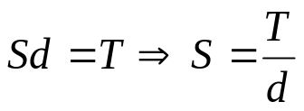
Free-body diagram of cross-section
section A-A (outboard of bay with cut-out, between bays 2 and 3)
d
A shear force S must be present at A₁; but since the section is in force equilibrium, an equal and opposite force must develop at A₂
This force couple are the only forces (in z dir) acting on the cross-section therefore they must make up the applied torque T
At the same time, the shear force S is the resultant of a shear flow q₁ acting in the skin panels of front and rear spars
rear spar bends up
h
A₂
front spar bends down
A₁
S
z
S
q₁
q₁
S
S

Slide 25
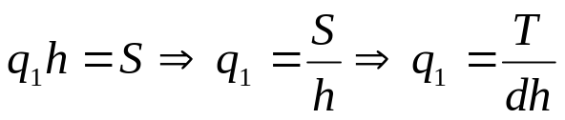
Free-body diagram of front spar
this permits calculation of the shear flow q₁ in the front and rear spars
q₁
h
q₁
S
note that this value of q₁ is twice the value of q that corresponds to a closed cross-section
T
S
we can now start drawing the free-body diagram of the front spar in the bay with the cut-out
q₁
q₁
as drawn, it satisfies force equilibrium but NOT moment equil.
q₁
q₁
STA 1500
STA 3000
S
S

Slide 26
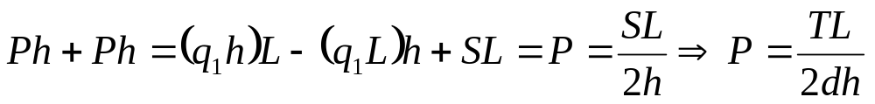
Free-body of front spar
to put the front spar in equilibrium, axial forces must develop in the corner flanges which must NOT violate the existing force equilibrium
compression!
P
P
q₁
q₁
q₁
h
q₁
O
P
P
compression!
S
S
L
Sta 1500
Sta 3000
and since P was introduced to balance the moments, it can be determined from moment equilibrium
taking moments about O

Slide 27
Alternative moment equilibrium of front spar
Note: Megson has two other ways of obtaining P, one of which may require some explanation
If we consider the deformed shape of the front spar,
(edge view)
P
q₁
q₁
P
P
q₁
S
q₁
P
S
By symmetry (since only torque is applied) the deformed shape of the front spar has a point of inflexion at its center (Megson calls it point of contraflexure)

Slide 28
Alternative moment equilibrium of front spar
inflexion point or point of contraflexure
P
q₁
q₁
P
P
q₁
S
q₁
P
inflexion pt
S
w
plotting the deflection w
slope of w goes through a maximum at the inflexion point of w => then the derivative of the slope, i.e. the 2nd derivative of w is zero at that location
w
slope of w
x

Slide 29
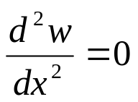
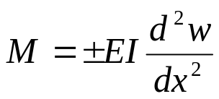
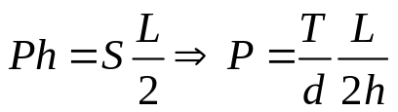
Alternative moment equilibrium of front spar
therefore, at the point of contraflexure (or inflexion)
but from beam theory (and treating the spar as a beam)
which means that the bending moment at the point of contraflexure is zero; then, taking moments about the center of the front spar
why is P=0 at the cut? (symmetry)
P
M=0
P
q₁
q₁
q₁
moments about this pt.
q₁
q₁
q₁
h
q₁
q₁
P
P
L/2
L/2
S
S
same as before

Slide 30
Moving on to the third bay
Rib
Applied torque

Slide 31
Free-body diagram of third bay
q₂
P
q₂
q₂
q₂
front spar
P
rear spar
P
q₃
q₃
q₃
q₃
q₃
q₃
q₃
q₃
T
q₂
q₂
q₂
q₂
Sta 3000
Sta 4500
Note: (1) Axial load in corner flanges is zero at sta 4500 where T is applied
(2) Same shear flow q₂ in upper and lower panels (symmetry of loading of diagonally opposite flanges)

Slide 32

Shear forces in corner flange give axial load
P
The signs of these should be reversed. See previous chart!
q₂
q₃
L
(one equation for q₂ and q₃)

Slide 33

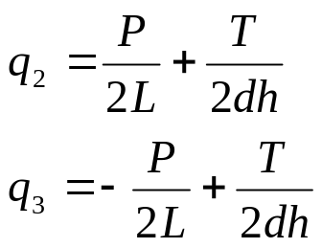
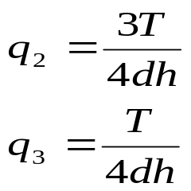
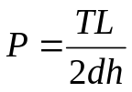
Recovering applied torque at end of bay 3
q₂
q₃
q₃
T
h
q₂
d
(moments about the center)
(second equation for q₂ and q₃)
solving the two equations for q₂ and q₃:
and using

Slide 34
Shear flows compared to q when there is no cut-out
if we substitute values, q₂=46.875 N/mm
and q₃=15.625 N/mm
q₂=1.5q
q₃=0.5q

Slide 35
Variation of axial load P along corner flange
so far, we have calculated (or inferred the value of) the axial load at certain stations
P=0 (beam is under pure torsion warping is neglected)
(max tension)
bay 1
P=0 (inflexion location)
STA 0
(max compr)
bay 2
P=0 (no axial load applied; only torque)
STA 1500
STA 2250
bay 3
Front spar
STA 3000
STA 4500
what happens to the axial load P in-between these locations?

Slide 36

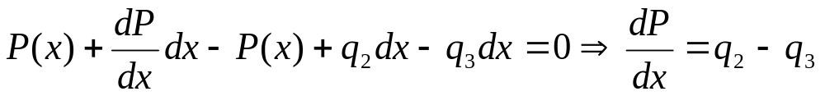
Variation of axial load P along corner flange
isolate an element of upper corner flange of length dx and put it in equilibrium (bay 3)
P(x)
q₂
q₃
dx
equilibrium in x direction (note q₂ and q₃ are constant)

Slide 37



Variation of axial load P along corner flange
and since q₂-q₃ is constant with x,
or, P is linear in x! (similarly for other two bays)
therefore, using the intermediate values calculated earlier, P as a function of distance along the upper corner flange of the front spar is given by
: calculated earlier
1500
3000

Slide 38

Shear flow in upper panel of bay 2
q₄
what is q₄?
P
q₄
q₄
q₄
P
P
P
P
q₁
q₁
q₁
q₁
q₁
q₁
q₁
q₁
L
P
P
Sta 1500
Sta 3000
the axial load in upper flange of fwd spar is given by (see previous page)

Slide 39
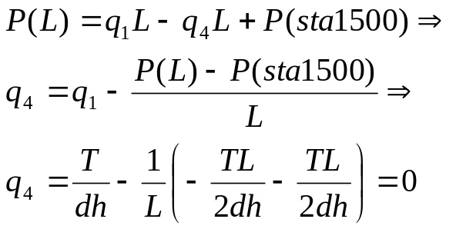
Shear flow in upper panel of bay 2
Noting that C=P at station 1500 (if we assume x=0 there), can solve for q₄
P(L)=P(3000); both P(3000) and P(1500) determined earlier
and there is NO shear flow in upper panel of bay 2
The directions of the forces and the signs are double dipped. As written it does not add up to zero!!

Slide 40
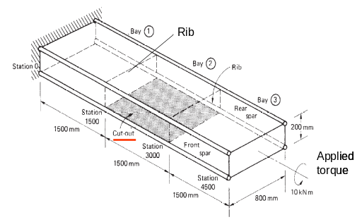
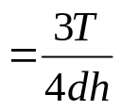
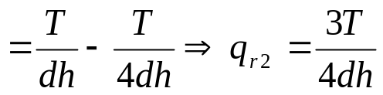
Shear flows in rib 2
consider free-body diagram of rib 2 and shear flows in adjacent panels
q_{r2}=q₂
q₁
q₁
q₁
rib 2
q₂
q₂
q₃
q₃
q₃
q_{r2}=q₁-q₃

Slide 41
Antisymmetry for the rest
flange 3
flange 1
flange 4
flange 2
loads in remaining flanges are obtained by anti-symmetry (flange 3 same as flange 1; flange 2 same as flange 4; flange 2 and flange 1 opposite signs)

